Slide 1

Maths 15
Differential Equations

Slide 2
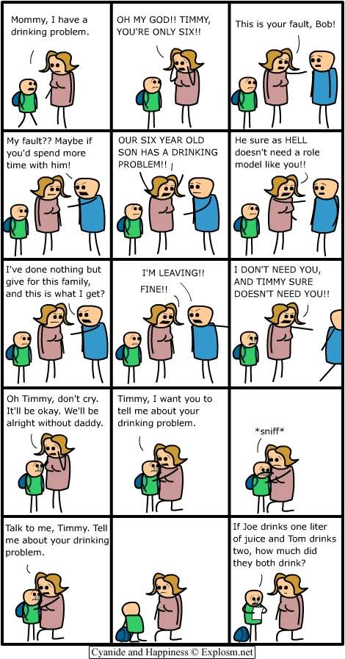

Differential Equations 2 - Solutions
$$nd=\ln\left(de^{s}\right)+\ln\left(\frac{Nu}{s}\right)$$
$$nd=ln⁡(de^{s}\left(\frac{Nu}{s}\right))$$
$$e^{nd}=de^{s}\left(\frac{Nu}{s}\right)$$
$$se^{nd}=de^{s}\left(Nu\right)$$
$$se^{nd}=Nude^{s}$$

Slide 3
Differential Equations 2 - Solutions
We’ve looked at what the structure of a differential equation is and how it can be used.
Now it is time to learn about actually solving them.

Slide 4
Differential Equations 2 - Solutions
The first of the ways to solve a differential equation is by separation of variables.
You can do this when you have a differential equation where you can move the variables to their own side. i.e. all the y on one side and all the x on the other.

Slide 5

Differential Equations 2 - Solutions
$$\frac{dy}{dx}=5y$$

Slide 6
Differential Equations 2 - Solutions
$$\frac{dy}{dx}=5y$$

Slide 7

Differential Equations 2 - Solutions
$$\frac{dy}{dxy}=5$$

Slide 8
Differential Equations 2 - Solutions
$$\frac{dy}{dxy}=5$$

Slide 9

Differential Equations 2 - Solutions
$$\frac{dy}{y}=5 dx$$

Slide 10

Differential Equations 2 - Solutions
$$\frac{dy}{y}=5 dx$$
Now we have arranged our differential equation with the variables on their respective sides.

Slide 11
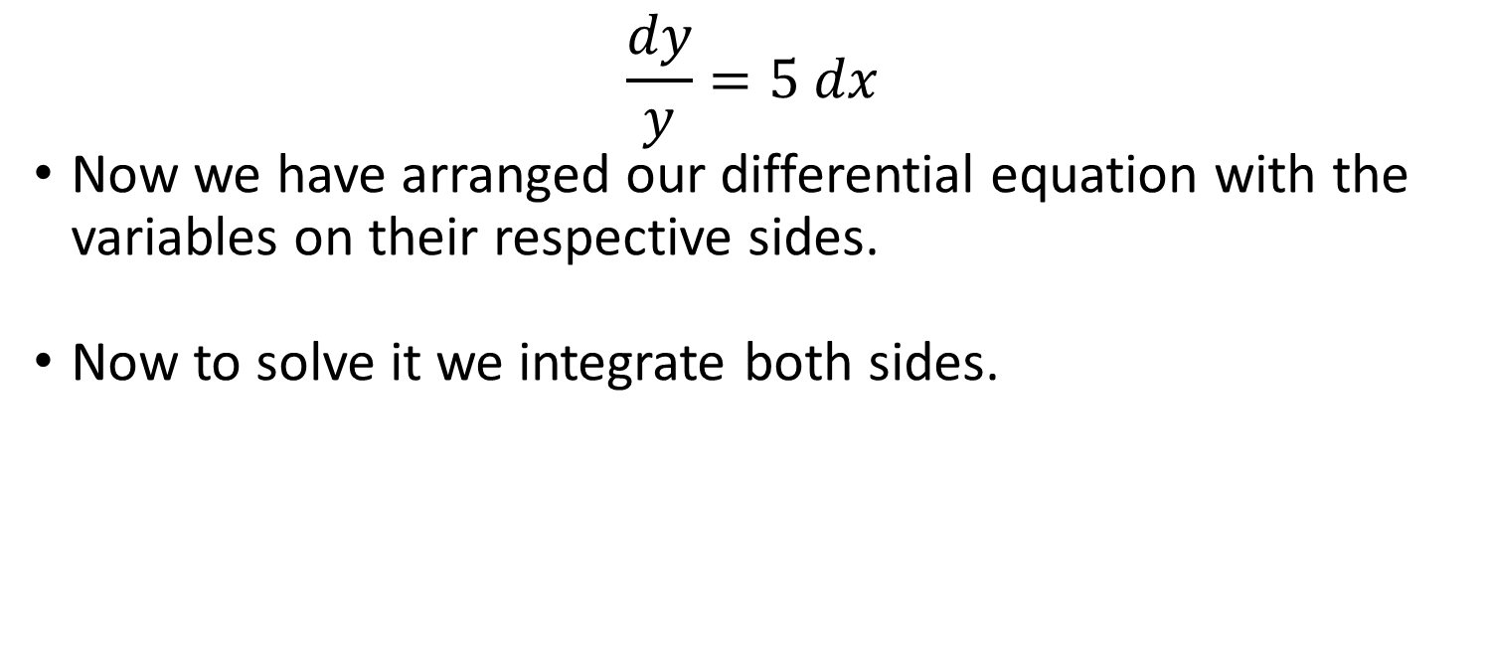
Differential Equations 2 - Solutions
$$\frac{dy}{y}=5 dx$$
Now we have arranged our differential equation with the variables on their respective sides.
Now to solve it we integrate both sides.

Slide 12
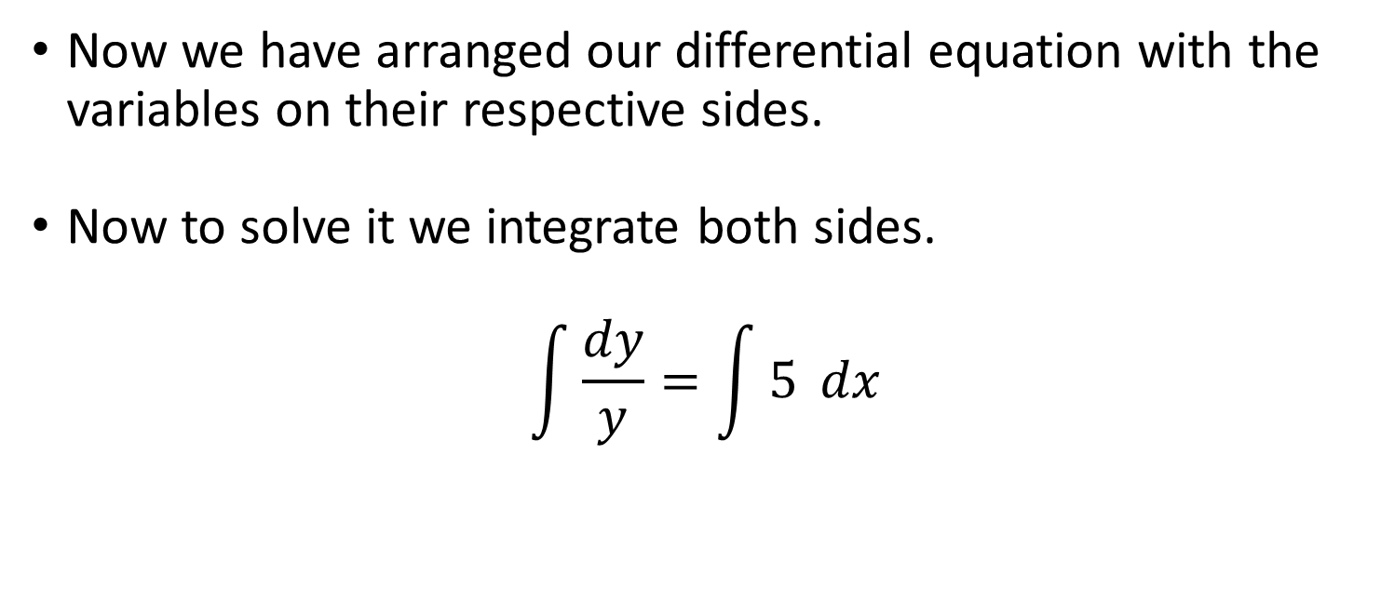
Differential Equations 2 - Solutions
Now we have arranged our differential equation with the variables on their respective sides.
Now to solve it we integrate both sides.
$$\int{\frac{dy}{y}}=\int{5} dx$$

Slide 13
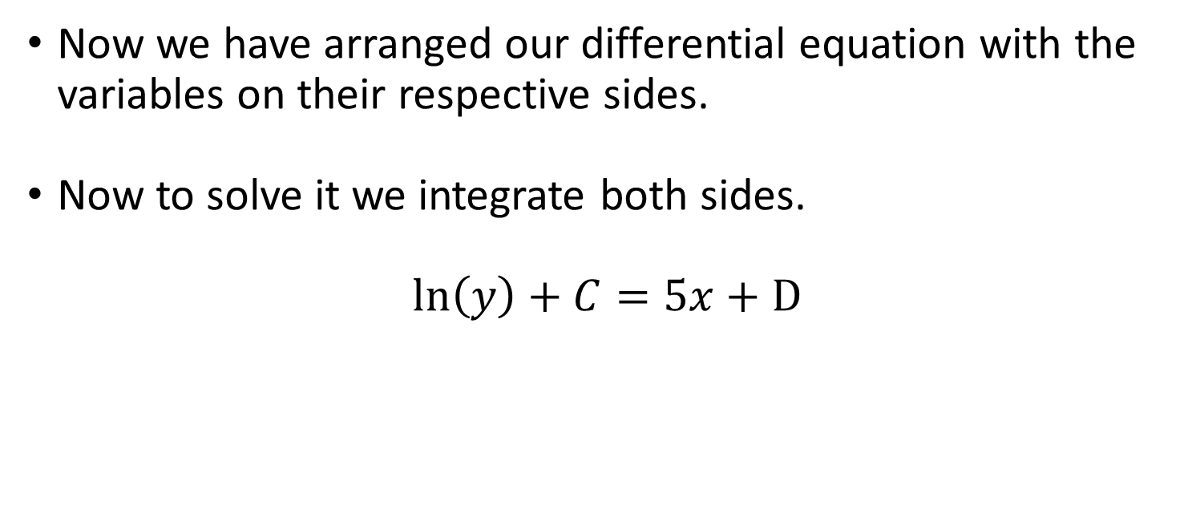
Differential Equations 2 - Solutions
Now we have arranged our differential equation with the variables on their respective sides.
Now to solve it we integrate both sides.
$$\ln\left(y\right)+C=5x+D$$

Slide 14
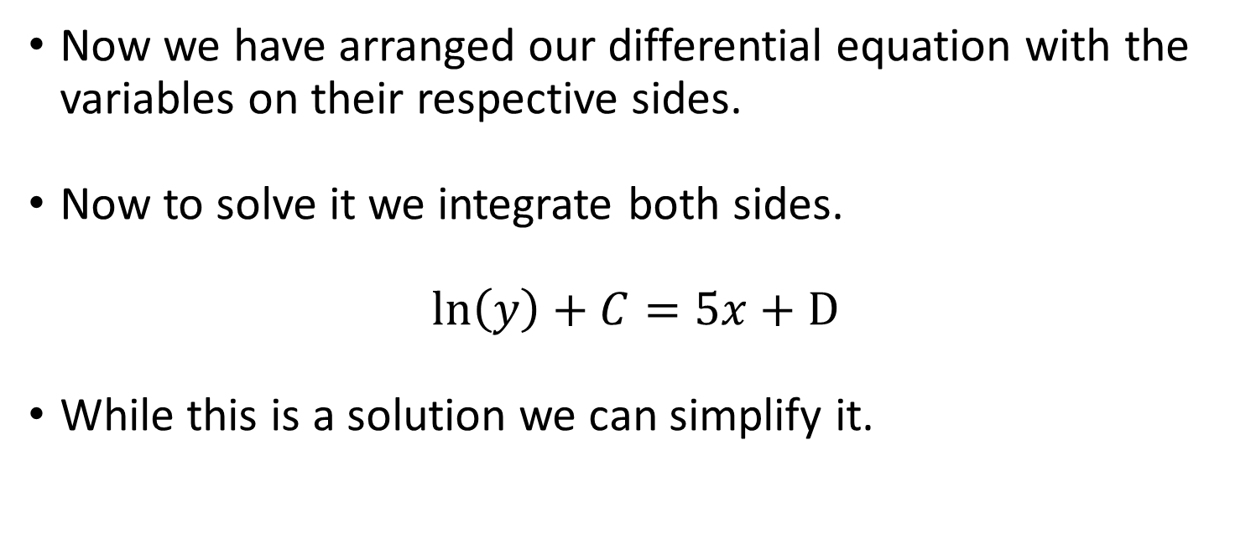
Differential Equations 2 - Solutions
Now we have arranged our differential equation with the variables on their respective sides.
Now to solve it we integrate both sides.
$$\ln\left(y\right)+C=5x+D$$
While this is a solution we can simplify it.

Slide 15
Differential Equations 2 - Solutions
Now we have arranged our differential equation with the variables on their respective sides.
Now to solve it we integrate both sides.
$$\ln\left(y\right)+C=5x+D$$
While this is a solution we can simplify it.

Slide 16

Differential Equations 2 - Solutions
Simplify it
$$\ln\left(y\right)+C=5x+D$$

Slide 17

Differential Equations 2 - Solutions
Simplify it
$$\ln\left(y\right)+C=5x+D$$
We can combine constants into a new one D – C = a

Slide 18

Differential Equations 2 - Solutions
Simplify it
$$\ln\left(y\right)=5x+a$$
We can combine constants into a new one D – C = a

Slide 19

Differential Equations 2 - Solutions
Simplify it
$$\ln\left(y\right)=5x+a$$
Now raise it to e

Slide 20

Differential Equations 2 - Solutions
Simplify it
$$y=e^{5x+a}$$
Now raise it to e

Slide 21

Differential Equations 2 - Solutions
Simplify it
$$y=e^{5x+a}$$
We can keep going.

Slide 22

Differential Equations 2 - Solutions
Simplify it
$$y=e^{5x}e^{a}$$
We can keep going.

Slide 23

Differential Equations 2 - Solutions
Simplify it
$$y=e^{5x}e^{a}$$
eª is its self another constant lets call it c.

Slide 24

Differential Equations 2 - Solutions
Simplify it
$$y={ce}^{5x}$$
eª is its self another constant lets call it c.

Slide 25

Differential Equations 2 - Solutions
Simplify it
$$y={ce}^{5x}$$
And done, we have found a general solution to the differential equation.

Slide 26

Differential Equations 2 - Solutions
Lets try our pandas:
$$\frac{dN}{dt}=rN$$

Slide 27

Differential Equations 2 - Solutions
Lets try our pandas:
$$dN=rN dt$$

Slide 28

Differential Equations 2 - Solutions
Lets try our pandas:
$$\frac{dN}{N}=r dt$$
Now we integrate to solve.

Slide 29

Differential Equations 2 - Solutions
Lets try our pandas:
$$\int{\frac{1}{N} dN}=\int{r dt}$$
Now we integrate to solve.

Slide 30

Differential Equations 2 - Solutions
Lets try our pandas:
$$\int{\frac{1}{N} dN}= rt+D$$
Now we integrate to solve.

Slide 31

Differential Equations 2 - Solutions
Lets try our pandas:
$$\ln\left(N\right)+C= rt+D$$
Now we integrate to solve.

Slide 32

Differential Equations 2 - Solutions
Lets try our pandas:
$$\ln\left(N\right)+C= rt+D$$
Combine our constants as C – D to a

Slide 33

Differential Equations 2 - Solutions
Lets try our pandas:
$$\ln\left(N\right)= rt+a$$
Combine our constants as C – D to a

Slide 34

Differential Equations 2 - Solutions
Lets try our pandas:
$$\ln\left(N\right)= rt+a$$
Exp it to get just N

Slide 35

Differential Equations 2 - Solutions
Lets try our pandas:
$$N=e^{rt+a}$$
Exp it to get just N

Slide 36

Differential Equations 2 - Solutions
Lets try our pandas:
$$N=e^{rt+a}$$
Remember e^{rt+a} = eª e^{rt} and eª and this can be a constant c

Slide 37

Differential Equations 2 - Solutions
Lets try our pandas:
$$N={ce}^{rt}$$
Remember e^{rt+a} = eª e^{rt} and eª and this can be a constant c

Slide 38

Differential Equations 2 - Solutions
Lets try our pandas:
$$N={ce}^{rt}$$
This is the solution to a differential equation for my panda problem.

Slide 39

Differential Equations 2 - Solutions
But what about when we run out of cabbages again?
$$\frac{d}{dt}N=rN(1−\frac{N}{k})$$

Slide 40
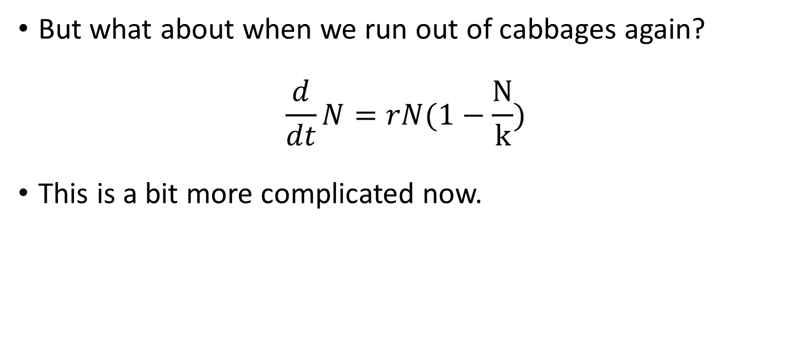
Differential Equations 2 - Solutions
But what about when we run out of cabbages again?
$$\frac{d}{dt}N=rN(1−\frac{N}{k})$$
This is a bit more complicated now.

Slide 41
Differential Equations 2 - Solutions
But what about when we run out of cabbages again?
$$\frac{d}{dt}N=rN(1−\frac{N}{k})$$
This is a bit more complicated now.

Slide 42

Differential Equations 2 - Solutions
But what about when we run out of cabbages again?
$$\frac{d}{dt}N=rN(1−\frac{N}{k})$$
Times by dt again

Slide 43

Differential Equations 2 - Solutions
But what about when we run out of cabbages again?
$$dN=rN\left(1−\frac{N}{k}\right)dt$$
Times by dt again

Slide 44
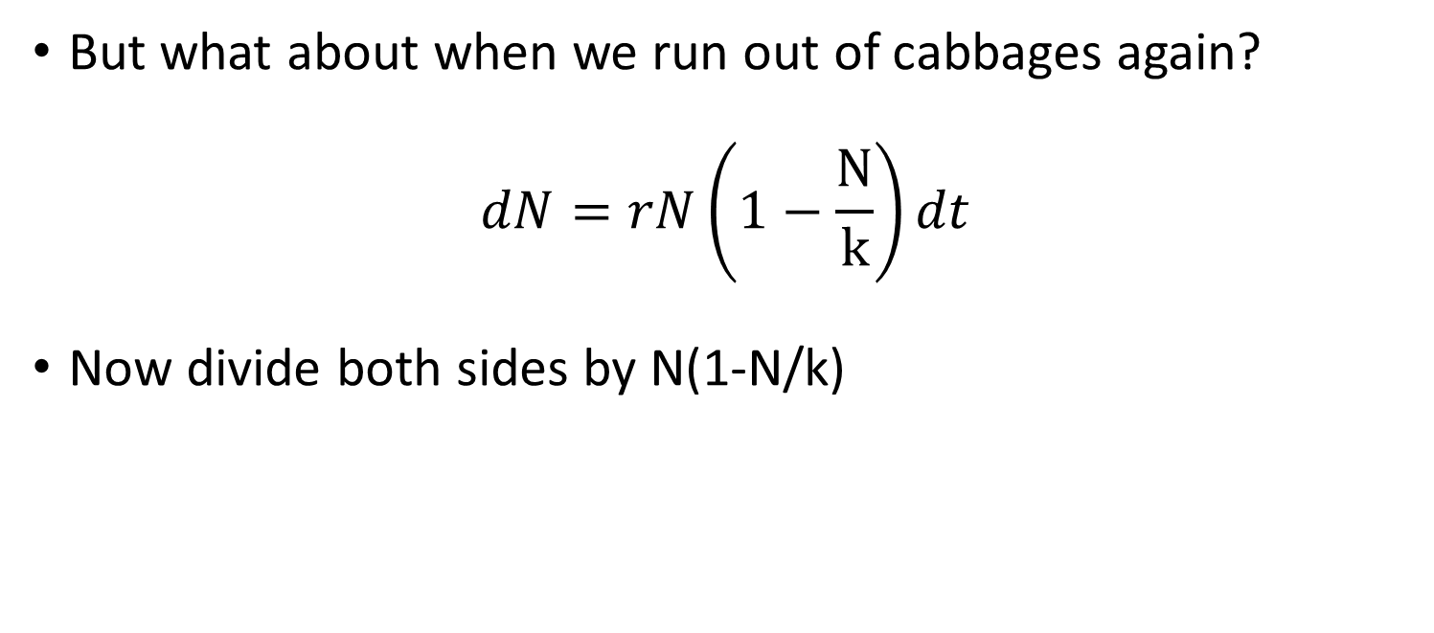
Differential Equations 2 - Solutions
But what about when we run out of cabbages again?
$$dN=rN\left(1−\frac{N}{k}\right)dt$$
Now divide both sides by N(1-N/k)

Slide 45
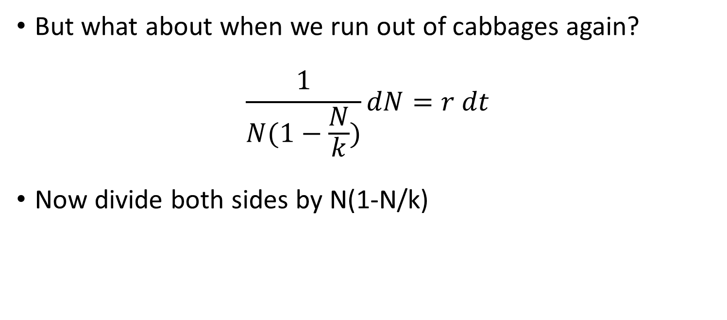
Differential Equations 2 - Solutions
But what about when we run out of cabbages again?
$$\frac{1}{N(1−\frac{N}{k})}dN=r dt$$
Now divide both sides by N(1-N/k)

Slide 46
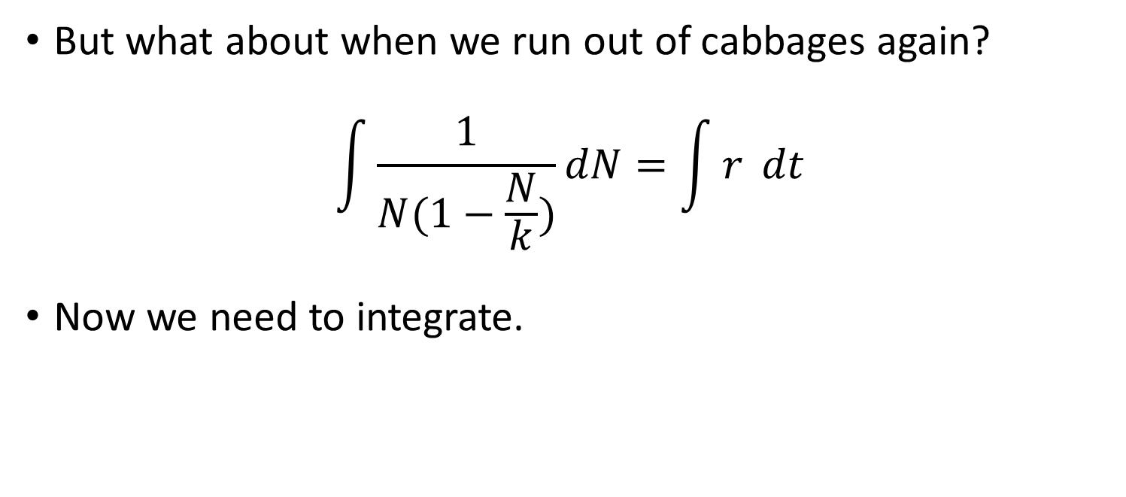
Differential Equations 2 - Solutions
But what about when we run out of cabbages again?
$$\int{\frac{1}{N(1−\frac{N}{k})}}dN=\int{r} dt$$
Now we need to integrate.

Slide 47
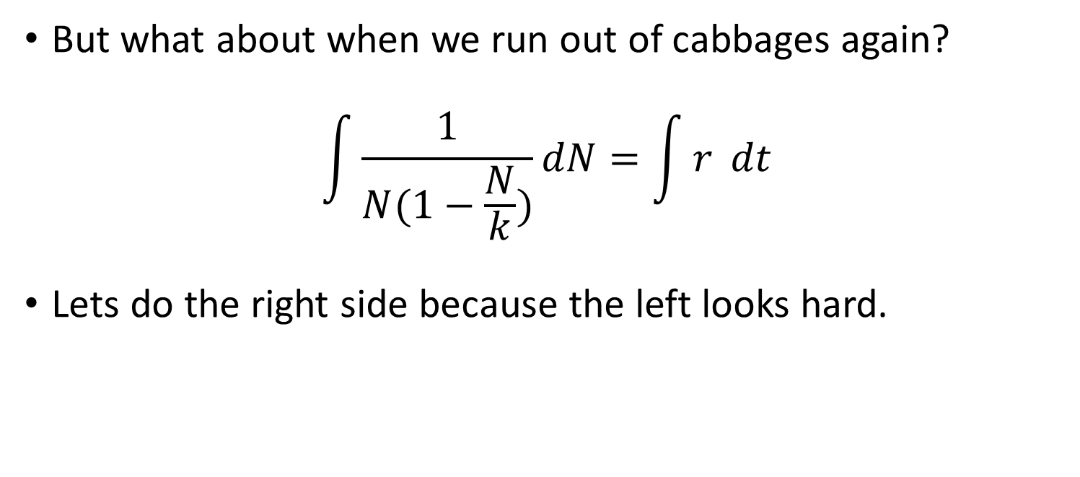
Differential Equations 2 - Solutions
But what about when we run out of cabbages again?
$$\int{\frac{1}{N(1−\frac{N}{k})}}dN=\int{r} dt$$
Lets do the right side because the left looks hard.

Slide 48
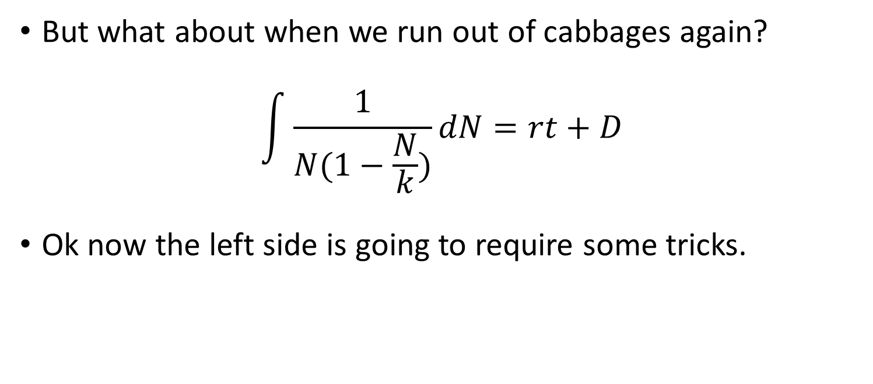
Differential Equations 2 - Solutions
But what about when we run out of cabbages again?
$$\int{\frac{1}{N(1−\frac{N}{k})}}dN=rt+D$$
Ok now the left side is going to require some tricks.

Slide 49
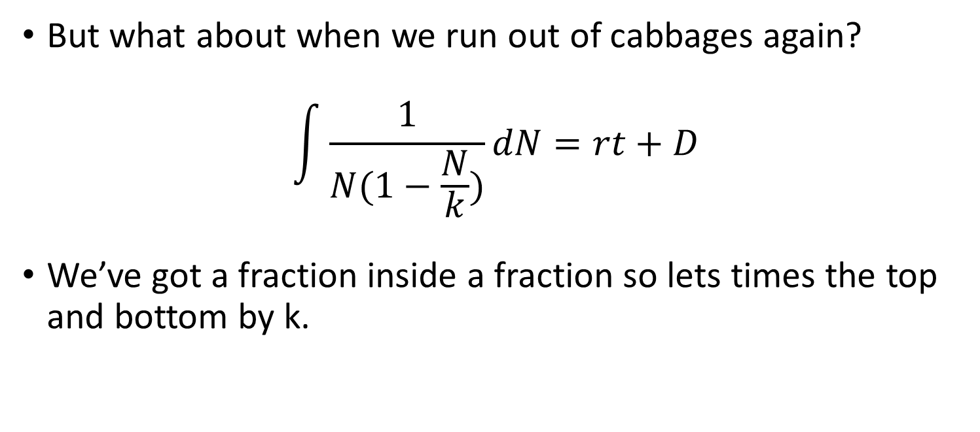
Differential Equations 2 - Solutions
But what about when we run out of cabbages again?
$$\int{\frac{1}{N(1−\frac{N}{k})}}dN=rt+D$$
We’ve got a fraction inside a fraction so lets times the top and bottom by k.

Slide 50
Differential Equations 2 - Solutions
But what about when we run out of cabbages again?
$$\int{\frac{1}{N(1−\frac{N}{k})}}dN=rt+D$$
We’ve got a fraction inside a fraction so lets times the top and bottom by k.

Slide 51
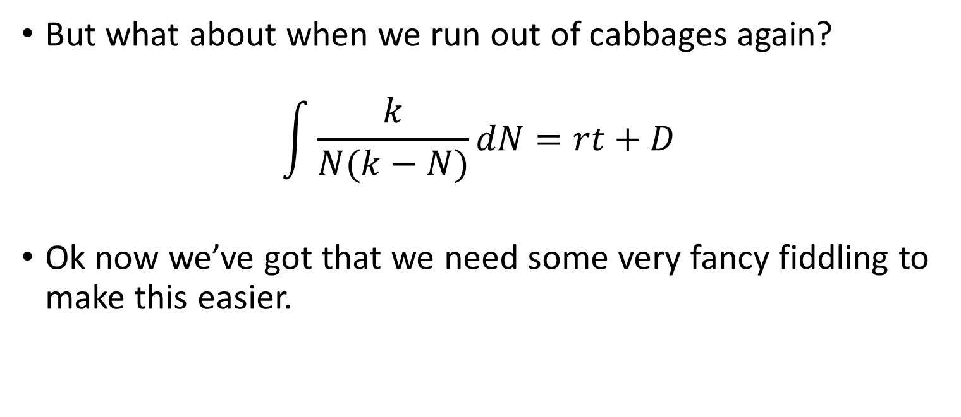
Differential Equations 2 - Solutions
But what about when we run out of cabbages again?
$$\int{\frac{k}{N(k−N)}}dN=rt+D$$
Ok now we’ve got that we need some very fancy fiddling to make this easier.

Slide 52
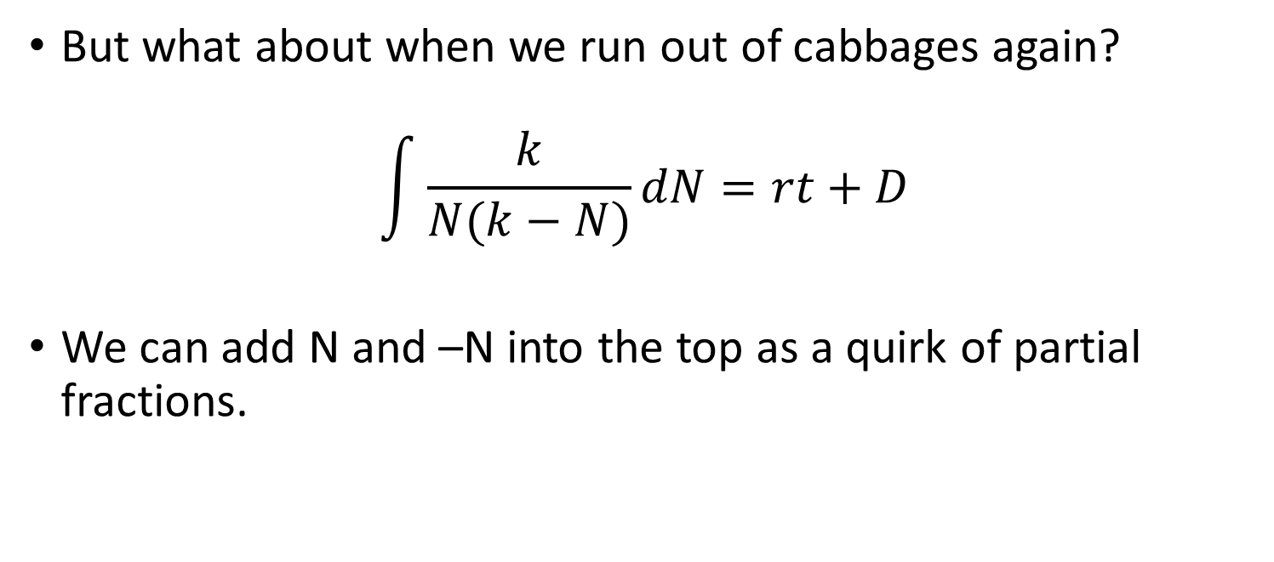
Differential Equations 2 - Solutions
But what about when we run out of cabbages again?
$$\int{\frac{k}{N(k−N)}}dN=rt+D$$
We can add N and –N into the top as a quirk of partial fractions.

Slide 53
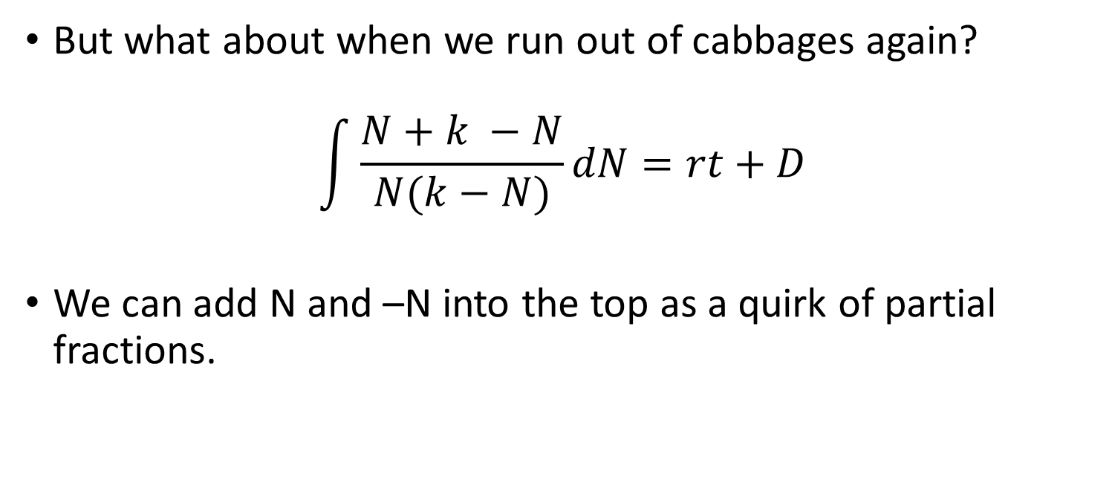
Differential Equations 2 - Solutions
But what about when we run out of cabbages again?
$$\int{\frac{N+k −N}{N(k−N)}}dN=rt+D$$
We can add N and –N into the top as a quirk of partial fractions.

Slide 54
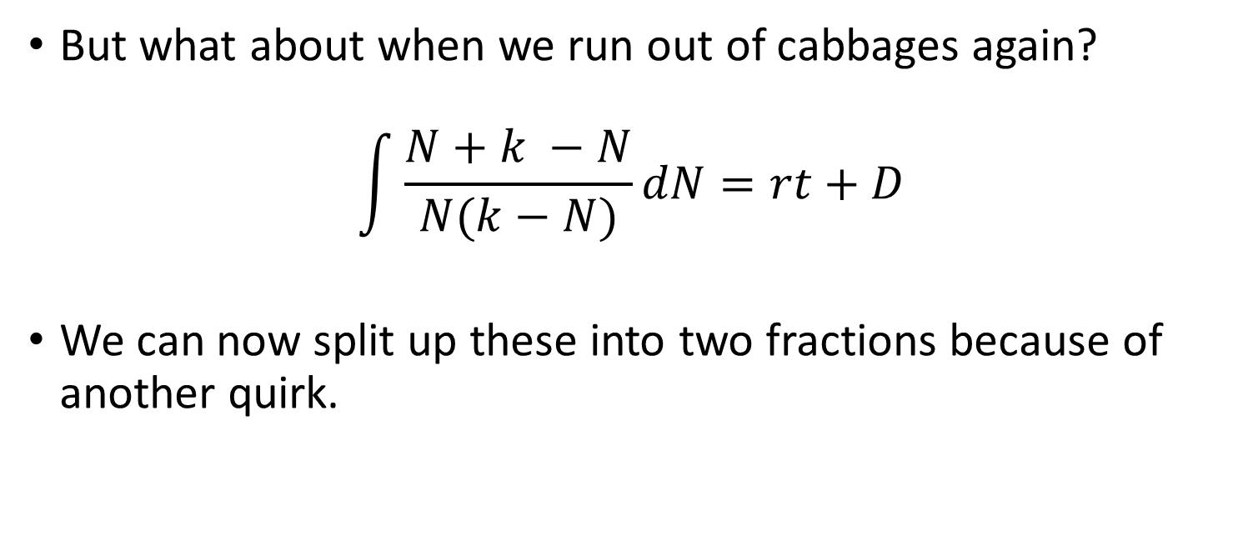
Differential Equations 2 - Solutions
But what about when we run out of cabbages again?
$$\int{\frac{N+k −N}{N(k−N)}}dN=rt+D$$
We can now split up these into two fractions because of another quirk.

Slide 55
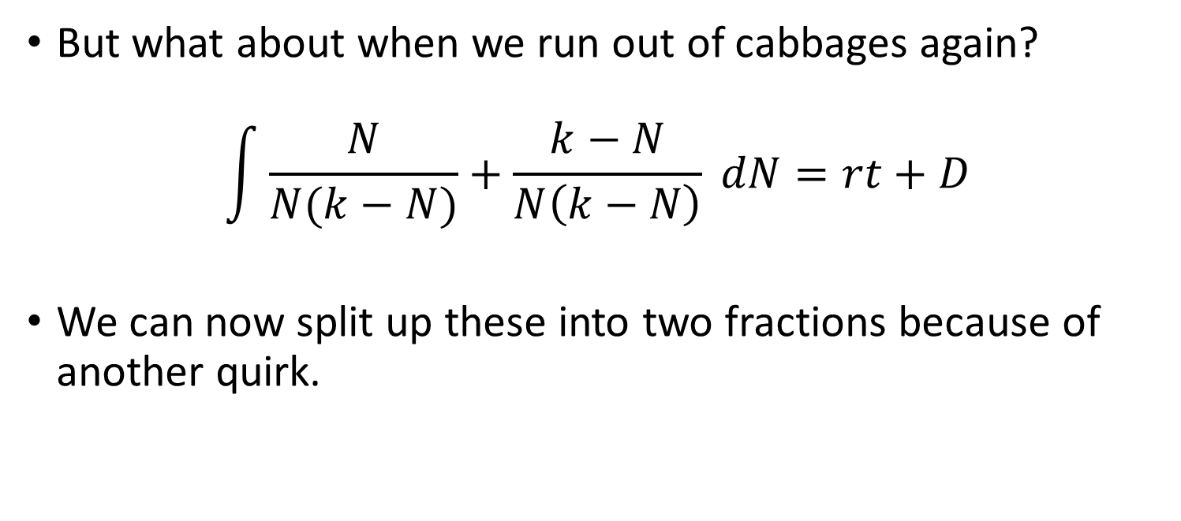
Differential Equations 2 - Solutions
But what about when we run out of cabbages again?
$$\int{\frac{N}{N(k−N)}+\frac{k−N}{N\left(k−N\right)} }dN=rt+D$$
We can now split up these into two fractions because of another quirk.

Slide 56
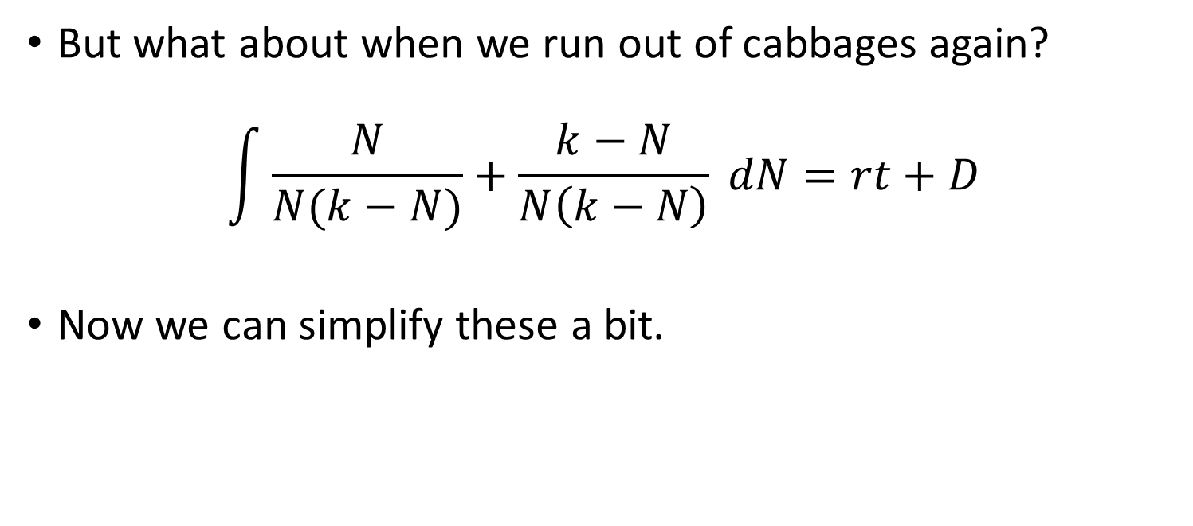
Differential Equations 2 - Solutions
But what about when we run out of cabbages again?
$$\int{\frac{N}{N(k−N)}+\frac{k−N}{N\left(k−N\right)} }dN=rt+D$$
Now we can simplify these a bit.

Slide 57
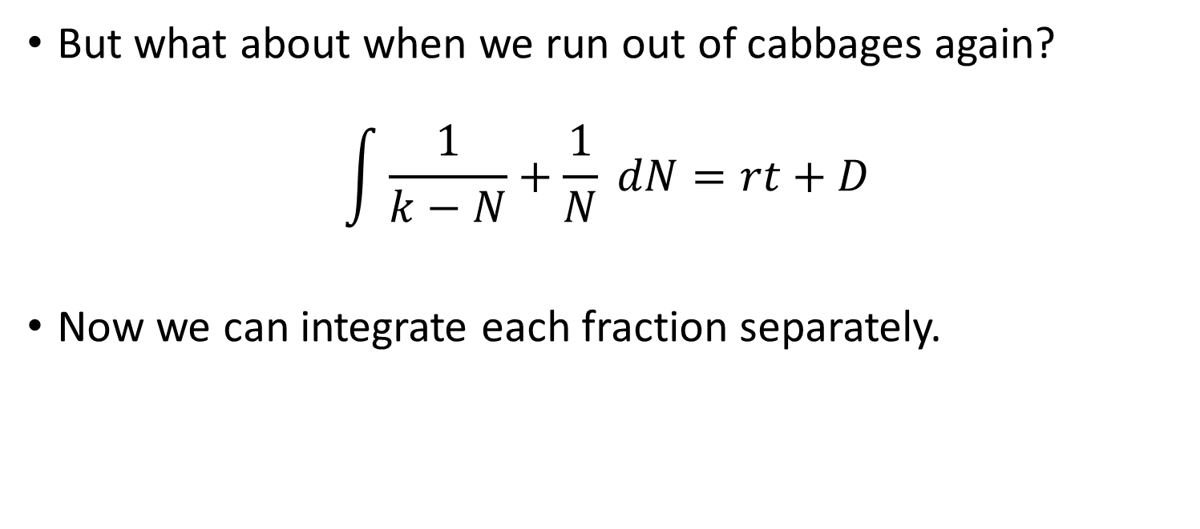
Differential Equations 2 - Solutions
But what about when we run out of cabbages again?
$$\int{\frac{1}{k−N}+\frac{1}{N} }dN=rt+D$$
Now we can integrate each fraction separately.

Slide 58

Differential Equations 2 - Solutions
But what about when we run out of cabbages again?
$$\int{\frac{1}{k−N}dN+\int{\frac{1}{N}} }dN=rt+D$$
Now we can integrate each fraction separately.

Slide 59

Differential Equations 2 - Solutions
But what about when we run out of cabbages again?
$$−ln\left(k−N\right)+ln⁡(N)=rt+D$$
Now we can integrate each fraction separately.
Note as we are integrating 1/k-N in respect for –N it becomes –ln()

Slide 60
Differential Equations 2 - Solutions
But what about when we run out of cabbages again?
$$−ln\left(k−N\right)+ln⁡(N)=rt+D$$
Now we can integrate each fraction separately.
Note as we are integrating 1/k-N in respect for –N it becomes –ln()

Slide 61

Differential Equations 2 - Solutions
But what about when we run out of cabbages again?
$$−ln\left(k−N\right)+ln⁡(N)=rt+D$$
Reverse the sign on either side.

Slide 62

Differential Equations 2 - Solutions
But what about when we run out of cabbages again?
$$\ln\left(k−N\right)−\ln\left(N\right)=−rt−D$$
Reverse the signs on either side.

Slide 63

Differential Equations 2 - Solutions
But what about when we run out of cabbages again?
$$\ln\left(k−N\right)−\ln\left(N\right)=−rt−D$$
An ln – an ln is ln(x/y)

Slide 64

Differential Equations 2 - Solutions
But what about when we run out of cabbages again?
$$\ln\left(k−N/N\right)=−rt−D$$
An ln – an ln is ln(x/y)

Slide 65

Differential Equations 2 - Solutions
But what about when we run out of cabbages again?
$$\ln\left(k−N/N\right)=−rt−D$$
Bring it to the e

Slide 66

Differential Equations 2 - Solutions
But what about when we run out of cabbages again?
$$(k−N)/N=e^{−rt−D}$$
Bring it to the e

Slide 67

Differential Equations 2 - Solutions
But what about when we run out of cabbages again?
$$(k−N)/N=e^{−rt−D}$$
Same as before separate the e

Slide 68

Differential Equations 2 - Solutions
But what about when we run out of cabbages again?
$$(k−N)/N=e^{−rt}e^{−D}$$
Same as before separate the e

Slide 69

Differential Equations 2 - Solutions
But what about when we run out of cabbages again?
$$(k−N)/N=e^{−rt}e^{−D}$$
Make e^{-D} a constant

Slide 70

Differential Equations 2 - Solutions
But what about when we run out of cabbages again?
$$(k−N)/N={Ae}^{−rt}$$
Make e^{-D} a constant

Slide 71

Differential Equations 2 - Solutions
But what about when we run out of cabbages again?
$$\frac{k−N}{N}={Ae}^{−rt}$$
Ok nearly there but we want Just N on one side.

Slide 72

Differential Equations 2 - Solutions
But what about when we run out of cabbages again?
$$\frac{k−N}{N}={Ae}^{−rt}$$
Remember a – fraction is a combined fraction.

Slide 73

Differential Equations 2 - Solutions
But what about when we run out of cabbages again?
$$\frac{k}{N}−\frac{N}{N}={Ae}^{−rt}$$
Remember a – fraction is a combined fraction.

Slide 74

Differential Equations 2 - Solutions
But what about when we run out of cabbages again?
$$\frac{k}{N}−1={Ae}^{−rt}$$
N/N becomes 1 we’re getting closer.

Slide 75

Differential Equations 2 - Solutions
But what about when we run out of cabbages again?
$\frac{k}{N}={Ae}^{−rt}+1$
-1 from both sides.

Slide 76

Differential Equations 2 - Solutions
But what about when we run out of cabbages again?
$\frac{k}{N}={Ae}^{−rt}+1$
Last step is to get N on it’s own.

Slide 77

Differential Equations 2 - Solutions
But what about when we run out of cabbages again?
$N={\frac{k}{Ae^{−rt}+1}}^{}$
Done! This is the solution for a differential equation of a population with a carrying capacity k.

Slide 78
Differential Equations 2 - Solutions
But what about when we run out of cabbages again?
$N={\frac{k}{Ae^{−rt}+1}}^{}$
Done! This is the solution for a differential equation of a population with a carrying capacity k.

Slide 79
Differential Equations 2 - Solutions
There is a second form of differential equation that we have to learn to recognise.
First order linear differential equations.
These are differential equations that take a specific form.

Slide 80

Differential Equations 2 - Solutions
There is a second form of differential equation that we have to learn to recognise.
First order linear differential equations.
These are differential equations that take a specific form.
$\frac{dy}{dx}+P\left(x\right)y=Q(x)$

Slide 81

Differential Equations 2 - Solutions
First order linear differential equations.
$\frac{dy}{dx}+P\left(x\right)y=Q(x)$
Where P and Q are functions of x.
Having these functions here looks odd but a lot of things can be a function.

Slide 82

Differential Equations 2 - Solutions
First order linear differential equations.
$\frac{dy}{dx}+P\left(x\right)y=Q(x)$
To solve this we use the same tricks we did in the product rule of differentiation where we create new variables.

Slide 83

Differential Equations 2 - Solutions
First order linear differential equations.
$\frac{dy}{dx}+P\left(x\right)y=Q(x)$
We create a combine variable for y. where y = uv.
There is nothing to stop us creating variables like that. Y still exists we are just calling it something else.

Slide 84

Differential Equations 2 - Solutions
First order linear differential equations.
$\frac{dy}{dx}+P\left(x\right)y=Q(x)$
If you remember from the product rule when we have a differential of two functions like u and v
$$\frac{dy}{dx}=u\frac{dv}{dx}+v\frac{du}{dx}$$

Slide 85

Differential Equations 2 - Solutions
First order linear differential equations.
$\frac{dy}{dx}+P\left(x\right)y=Q(x)$
So we have made y = uv, sub these together.
$$\frac{dy}{dx}=u\frac{dv}{dx}+v\frac{du}{dx}$$

Slide 86

Differential Equations 2 - Solutions
First order linear differential equations.
$u\frac{dv}{dx}+v\frac{du}{dx}+P\left(x\right)uv=Q(x)$
So we have made y = uv, sub these together.
$$\frac{dy}{dx}=u\frac{dv}{dx}+v\frac{du}{dx}$$

Slide 87

Differential Equations 2 - Solutions
First order linear differential equations.
$u\frac{dv}{dx}+v\frac{du}{dx}+P\left(x\right)uv=Q(x)$
The best way to understand this is to try an example.

Slide 88

Differential Equations 2 - Solutions
First order linear differential equations.
$u\frac{dv}{dx}+v\frac{du}{dx}+P\left(x\right)uv=Q(x)$
The best way to understand this is to try an example:
$\frac{dy}{dx}−\frac{y}{x}=1$

Slide 89

Differential Equations 2 - Solutions
$\frac{dy}{dx}−\frac{y}{x}=1$
Ok so is this linear does it match our previous equation?

Slide 90

Differential Equations 2 - Solutions
$\frac{dy}{dx}−\frac{y}{x}=1$
Ok so is this linear does it match our previous equation?
Well we have a derivative first yes that’s right

Slide 91

Differential Equations 2 - Solutions
$\frac{dy}{dx}−\frac{y}{x}=1$
Ok so is this linear does it match our previous equation?
Well we have a derivative first yes that’s right
Hmmm P(x) and Q(x) though?

Slide 92

Differential Equations 2 - Solutions
$\frac{dy}{dx}−\frac{y}{x}=1$
Ok so is this linear does it match our previous equation?
Hmmm P(x) and Q(x) though?
Well yes P = -1/x and Q = 1

Slide 93

Differential Equations 2 - Solutions
$\frac{dy}{dx}−\frac{y}{x}=1$
Ok so we can use our method, first thing’s first we need to turn y into uv:

Slide 94

Differential Equations 2 - Solutions
$\frac{dy}{dx}−\frac{y}{x}=1$
Ok so we can use our method, first thing’s first we need to turn y into uv:
$$u\frac{dv}{dx}+v\frac{du}{dx} −\frac{uv}{x}=1$$

Slide 95

Differential Equations 2 - Solutions
$$u\frac{dv}{dx}+v\frac{du}{dx} −\frac{uv}{x}=1$$
Ok so we have our equation with u and v substituted in. What next?

Slide 96

Differential Equations 2 - Solutions
$$u\frac{dv}{dx}+v\frac{du}{dx} −\frac{uv}{x}=1$$
Ok so we have our equation with u and v substituted in. What next?
We pull the V’s out as a factor.

Slide 97

Differential Equations 2 - Solutions
$$u\frac{dv}{dx}+v\left(\frac{du}{dx} −\frac{u}{x}\right)=1$$
Ok so we have our equation with u and v substituted in. What next?
We pull the V’s out as a factor.

Slide 98
Differential Equations 2 - Solutions
$$u\frac{dv}{dx}+v\left(\frac{du}{dx} −\frac{u}{x}\right)=1$$
Ok so we have our equation with u and v substituted in. What next?
We pull the V’s out as a factor.

Slide 99

Differential Equations 2 - Solutions
$$u\frac{dv}{dx}+v\left(\frac{du}{dx} −\frac{u}{x}\right)=1$$
We pull the V’s out as a factor.
And now we set our “v term” (what is in the brackets) to 0.

Slide 100

Differential Equations 2 - Solutions
$$u\frac{dv}{dx}+v\left(\frac{du}{dx} −\frac{u}{x}\right)=1$$
We pull the V’s out as a factor.
And now we set our “v term” (what is in the brackets) to 0.
$$\frac{du}{dx} −\frac{u}{x}=0$$

Slide 101

Differential Equations 2 - Solutions
$$u\frac{dv}{dx}+v\left(\frac{du}{dx} −\frac{u}{x}\right)=1$$
$$\frac{du}{dx} −\frac{u}{x}=0$$
This is a differential equation again!
We can solve it by separating the variables.

Slide 102

Differential Equations 2 - Solutions
$$u\frac{dv}{dx}+v\left(\frac{du}{dx} −\frac{u}{x}\right)=1$$
$$\frac{du}{dx} =\frac{u}{x}$$

Slide 103

Differential Equations 2 - Solutions
$$u\frac{dv}{dx}+v\left(\frac{du}{dx} −\frac{u}{x}\right)=1$$
$$\frac{du}{dx} =\frac{u}{x}$$
$$\frac{du}{u}=\frac{dx}{x}$$

Slide 104

Differential Equations 2 - Solutions
$$u\frac{dv}{dx}+v\left(\frac{du}{dx} −\frac{u}{x}\right)=1$$
$$\frac{du}{u}=\frac{dx}{x}$$
Ok now integrate.

Slide 105
Differential Equations 2 - Solutions
$$u\frac{dv}{dx}+v\left(\frac{du}{dx} −\frac{u}{x}\right)=1$$
$$\frac{du}{u}=\frac{dx}{x}$$
Ok now integrate.

Slide 106

Differential Equations 2 - Solutions
$$u\frac{dv}{dx}+v\left(\frac{du}{dx} −\frac{u}{x}\right)=1$$
$$\int{\frac{du}{u}=}\int{\frac{dx}{x}}$$
Ok now integrate.

Slide 107

Differential Equations 2 - Solutions
$$u\frac{dv}{dx}+v\left(\frac{du}{dx} −\frac{u}{x}\right)=1$$
$$\ln\left(u\right)+C=\ln\left(x\right)+D$$
Ok now integrate.

Slide 108

Differential Equations 2 - Solutions
$$u\frac{dv}{dx}+v\left(\frac{du}{dx} −\frac{u}{x}\right)=1$$
$$\ln\left(u\right)+C=\ln\left(x\right)+D$$
Simplify

Slide 109

Differential Equations 2 - Solutions
$$u\frac{dv}{dx}+v\left(\frac{du}{dx} −\frac{u}{x}\right)=1$$
$$\ln\left(u\right)=\ln\left(x\right)+ln⁡(k)$$
Simplify
Lets make ln(k) = D-C

Slide 110

Differential Equations 2 - Solutions
$$u\frac{dv}{dx}+v\left(\frac{du}{dx} −\frac{u}{x}\right)=1$$
$$\ln\left(u\right)=\ln\left(x\right)+ln⁡(k)$$
Simplify
Now lets exp both sides

Slide 111

Differential Equations 2 - Solutions
$$u\frac{dv}{dx}+v\left(\frac{du}{dx} −\frac{u}{x}\right)=1$$
$u=kx$
Simplify
Now lets exp both sides

Slide 112

Differential Equations 2 - Solutions
$$u\frac{dv}{dx}+v\left(\frac{du}{dx} −\frac{u}{x}\right)=1$$
$u=kx$
Right we’ve solved u and turned our second v term into 0.

Slide 113

Differential Equations 2 - Solutions
$$u\frac{dv}{dx}+v\left(\frac{du}{dx} −\frac{u}{x}\right)=1$$
$u=kx$
Right we’ve solved u and turned our second v term into 0. so we are left with.
$$u\frac{dv}{dx}=1$$

Slide 114

Differential Equations 2 - Solutions
$$u\frac{dv}{dx}+v\left(\frac{du}{dx} −\frac{u}{x}\right)=1$$
$u=kx$
And we know what u is equal to.
$$u\frac{dv}{dx}=1$$

Slide 115

Differential Equations 2 - Solutions
$$u\frac{dv}{dx}+v\left(\frac{du}{dx} −\frac{u}{x}\right)=1$$
$u=kx$
And we know what u is equal to.
$$kx\frac{dv}{dx}=1$$

Slide 116

Differential Equations 2 - Solutions
$$u\frac{dv}{dx}+v\left(\frac{du}{dx} −\frac{u}{x}\right)=1$$
Separation of variables again.
$$kx\frac{dv}{dx}=1$$

Slide 117

Differential Equations 2 - Solutions
$$u\frac{dv}{dx}+v\left(\frac{du}{dx} −\frac{u}{x}\right)=1$$
Separation of variables again.
$$kxdv=dx$$

Slide 118

Differential Equations 2 - Solutions
$$u\frac{dv}{dx}+v\left(\frac{du}{dx} −\frac{u}{x}\right)=1$$
Separation of variables again.
$$kdv=\frac{dx}{x}$$

Slide 119

Differential Equations 2 - Solutions
$$u\frac{dv}{dx}+v\left(\frac{du}{dx} −\frac{u}{x}\right)=1$$
Separation of variables again.
$$\int{k dv}=\int{\frac{dx}{x}}$$

Slide 120

Differential Equations 2 - Solutions
$$u\frac{dv}{dx}+v\left(\frac{du}{dx} −\frac{u}{x}\right)=1$$
Separation of variables again.
$$kv+D=\int{\frac{dx}{x}}$$

Slide 121

Differential Equations 2 - Solutions
$$u\frac{dv}{dx}+v\left(\frac{du}{dx} −\frac{u}{x}\right)=1$$
Separation of variables again.
$$kv=\ln\left(x\right)+C$$

Slide 122

Differential Equations 2 - Solutions
$$u\frac{dv}{dx}+v\left(\frac{du}{dx} −\frac{u}{x}\right)=1$$
Separation of variables again.
Make C = ln(c)
$$kv=\ln\left(x\right)+C$$

Slide 123
Differential Equations 2 - Solutions
$$u\frac{dv}{dx}+v\left(\frac{du}{dx} −\frac{u}{x}\right)=1$$
Separation of variables again.
Make C = ln(c)
$$kv=\ln\left(x\right)+C$$

Slide 124

Differential Equations 2 - Solutions
$$u\frac{dv}{dx}+v\left(\frac{du}{dx} −\frac{u}{x}\right)=1$$
Separation of variables again.
Make C = ln(c)
$$kv=\ln\left(x\right)+ln⁡(c)$$

Slide 125

Differential Equations 2 - Solutions
$$u\frac{dv}{dx}+v\left(\frac{du}{dx} −\frac{u}{x}\right)=1$$
Separation of variables again.
$$kv=\ln\left(x\right)+ln⁡(c)$$

Slide 126
Differential Equations 2 - Solutions
$$u\frac{dv}{dx}+v\left(\frac{du}{dx} −\frac{u}{x}\right)=1$$
Separation of variables again.
$$kv=\ln\left(x\right)+ln⁡(c)$$

Slide 127

Differential Equations 2 - Solutions
$$u\frac{dv}{dx}+v\left(\frac{du}{dx} −\frac{u}{x}\right)=1$$
Separation of variables again.
$$kv=\ln\left(cx\right)$$

Slide 128

Differential Equations 2 - Solutions
$$u\frac{dv}{dx}+v\left(\frac{du}{dx} −\frac{u}{x}\right)=1$$
Separation of variables again.
$$v=\frac{1}{k}ln\left(cx\right)$$

Slide 129

Differential Equations 2 - Solutions
$$u\frac{dv}{dx}+v\left(\frac{du}{dx} −\frac{u}{x}\right)=1$$
Ok so we’ve solved u and v and if we remember y=uv, so we have solved y.
$$v=\frac{1}{k}ln\left(cx\right)$$

Slide 130

Differential Equations 2 - Solutions
Ok so we’ve solved u and v and if we remember y=uv, so we have solved y.
$$u=kx$$
$$v=\frac{1}{k}ln\left(cx\right)$$

Slide 131

Differential Equations 2 - Solutions
Ok so we’ve solved u and v and if we remember y=uv, so we have solved y.
$$u=kx$$
$$v=\frac{1}{k}ln\left(cx\right)$$
$$y=uv$$

Slide 132

Differential Equations 2 - Solutions
Ok so we’ve solved u and v and if we remember y=uv, so we have solved y.
$$u=kx$$
$$v=\frac{1}{k}ln\left(cx\right)$$
$$y=kx\frac{1}{k}ln⁡(cx)$$

Slide 133

Differential Equations 2 - Solutions
This is a solution for y of our differential equation.
$$y=kx\frac{1}{k}ln⁡(cx)$$
We can simplify it though.

Slide 134

Differential Equations 2 - Solutions
This is a solution for y of our differential equation.
$$y=xln⁡(cx)$$

